Slide 1

RAILWAY TICKET RESERVATION &
JOURNEY MANAGEMENT SYSTEM
Design and Implementation of a Relational Database Management System
REVIEW 1 • WEEK 7
Problem Identification • Literature Survey • Project Planning & SRS
Presented by: Komal Maniyar (25WU0102127)

Slide 2
Why This Project
Problem identification & objectives
THE PROBLEM
OBJECTIVES
Most college-level reservation projects track a booking as a single origin-to-destination record. Real railway travel doesn't work that way — a train picks up and drops passengers at every stop along a route, and the same physical seat can legally be resold to a different passenger for a later, non-overlapping segment of the journey.
Once seat allocation isn't modelled segment-by-segment, two passengers can be handed the same seat on overlapping stretches of track, waitlists lose their ordering during cancellations, and refund/fare logic has nothing reliable to calculate from. This project designs a schema where the data itself prevents that class of error, rather than relying on the application layer to catch it after the fact.
1
Model the domain correctly
Capture trains, stations, routes, stops, coaches, seats and schedules as a proper ER model, not a flat booking table.
2
Enforce segment-wise seat logic
A seat is available or blocked per stretch of the journey — not for the whole train run.
3
Normalize to 3NF
Remove redundancy and update anomalies before writing a single line of SQL.
4
Back it with real constraints
PK/FK, UNIQUE, NOT NULL, CHECK and DEFAULT — not application-side validation alone.
Railway Ticket Reservation & Journey Management System
Review 1 | 2

Slide 3
Who Uses It, What It Must Do
User roles & functional requirements
USER ROLES
CORE FUNCTIONAL REQUIREMENTS
P
Passenger
Search trains by route, date and available class
Searches trains, books/cancels tickets, tracks waitlist and payment status.
Check segment-wise seat availability before confirming
Book, cancel and auto-promote from the waitlist in order
B
Booking Clerk / Admin
Manages schedules, fares, coach layouts and handles counter bookings.
Calculate fare by distance, class and route
Record and reconcile payments against bookings
S
System (automated)
Runs waitlist promotion, seat-conflict checks and report generation on its own.
Generate availability, occupancy, revenue and journey reports
Railway Ticket Reservation & Journey Management System
Review 1 | 3

Slide 4
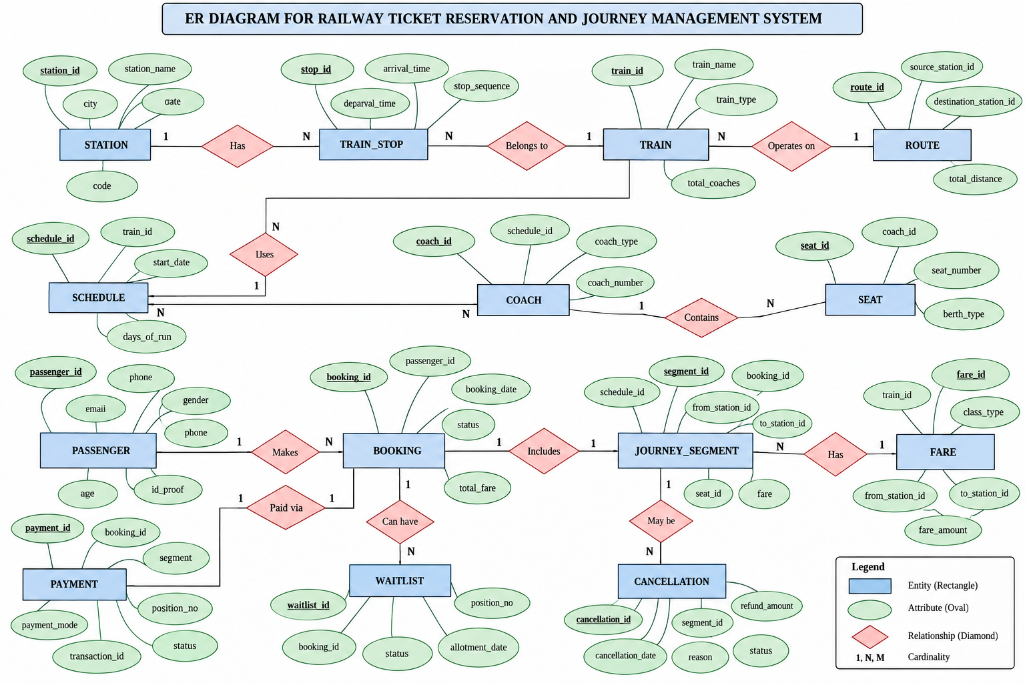
Conceptual Design — ER Diagram
13 entities across infrastructure, train setup, booking and finance
Railway Ticket Reservation & Journey Management System
Review 1 | 4

Slide 5
Initial Relational Schema
13 base tables, grouped by function — normalization to 3NF happens next
INFRASTRUCTURE
TRAIN SETUP
BOOKING CORE
FINANCE
Station
Schedule
Passenger
Fare
PK: station_id
PK: schedule_id
PK: passenger_id
PK: fare_id
Route
Coach
Booking
Payment
PK: route_id
PK: coach_id
PK: booking_id
PK: payment_id
Train
Seat
Journey_Segment
PK: train_id
PK: seat_id
PK: segment_id
Train_Stop
Waitlist
PK: stop_id
PK: waitlist_id
Railway Ticket Reservation & Journey Management System
Review 1 | 5

Slide 6
Review 1 — Where We Stand
COMPLETED FOR THIS REVIEW
Problem identified: segment-wise seat conflicts in naive booking designs
NEXT — TOWARD REVIEW 2 (WEEK 11)
1.
Normalize the schema to 3NF and finalize constraints (CHECK, UNIQUE, DEFAULT)
Scope, users and functional requirements finalized
Conceptual ER diagram covering all 13 entities completed
2.
Implement the database in MySQL/PostgreSQL with sample data
Initial relational schema with primary keys and FK relationships drafted
3.
Build the Java/Python front end for search, booking and cancellation
4.
Demonstrate a working prototype with core reports
Railway Ticket Reservation & Journey Management System
Review 1 | 6

